Slide 1
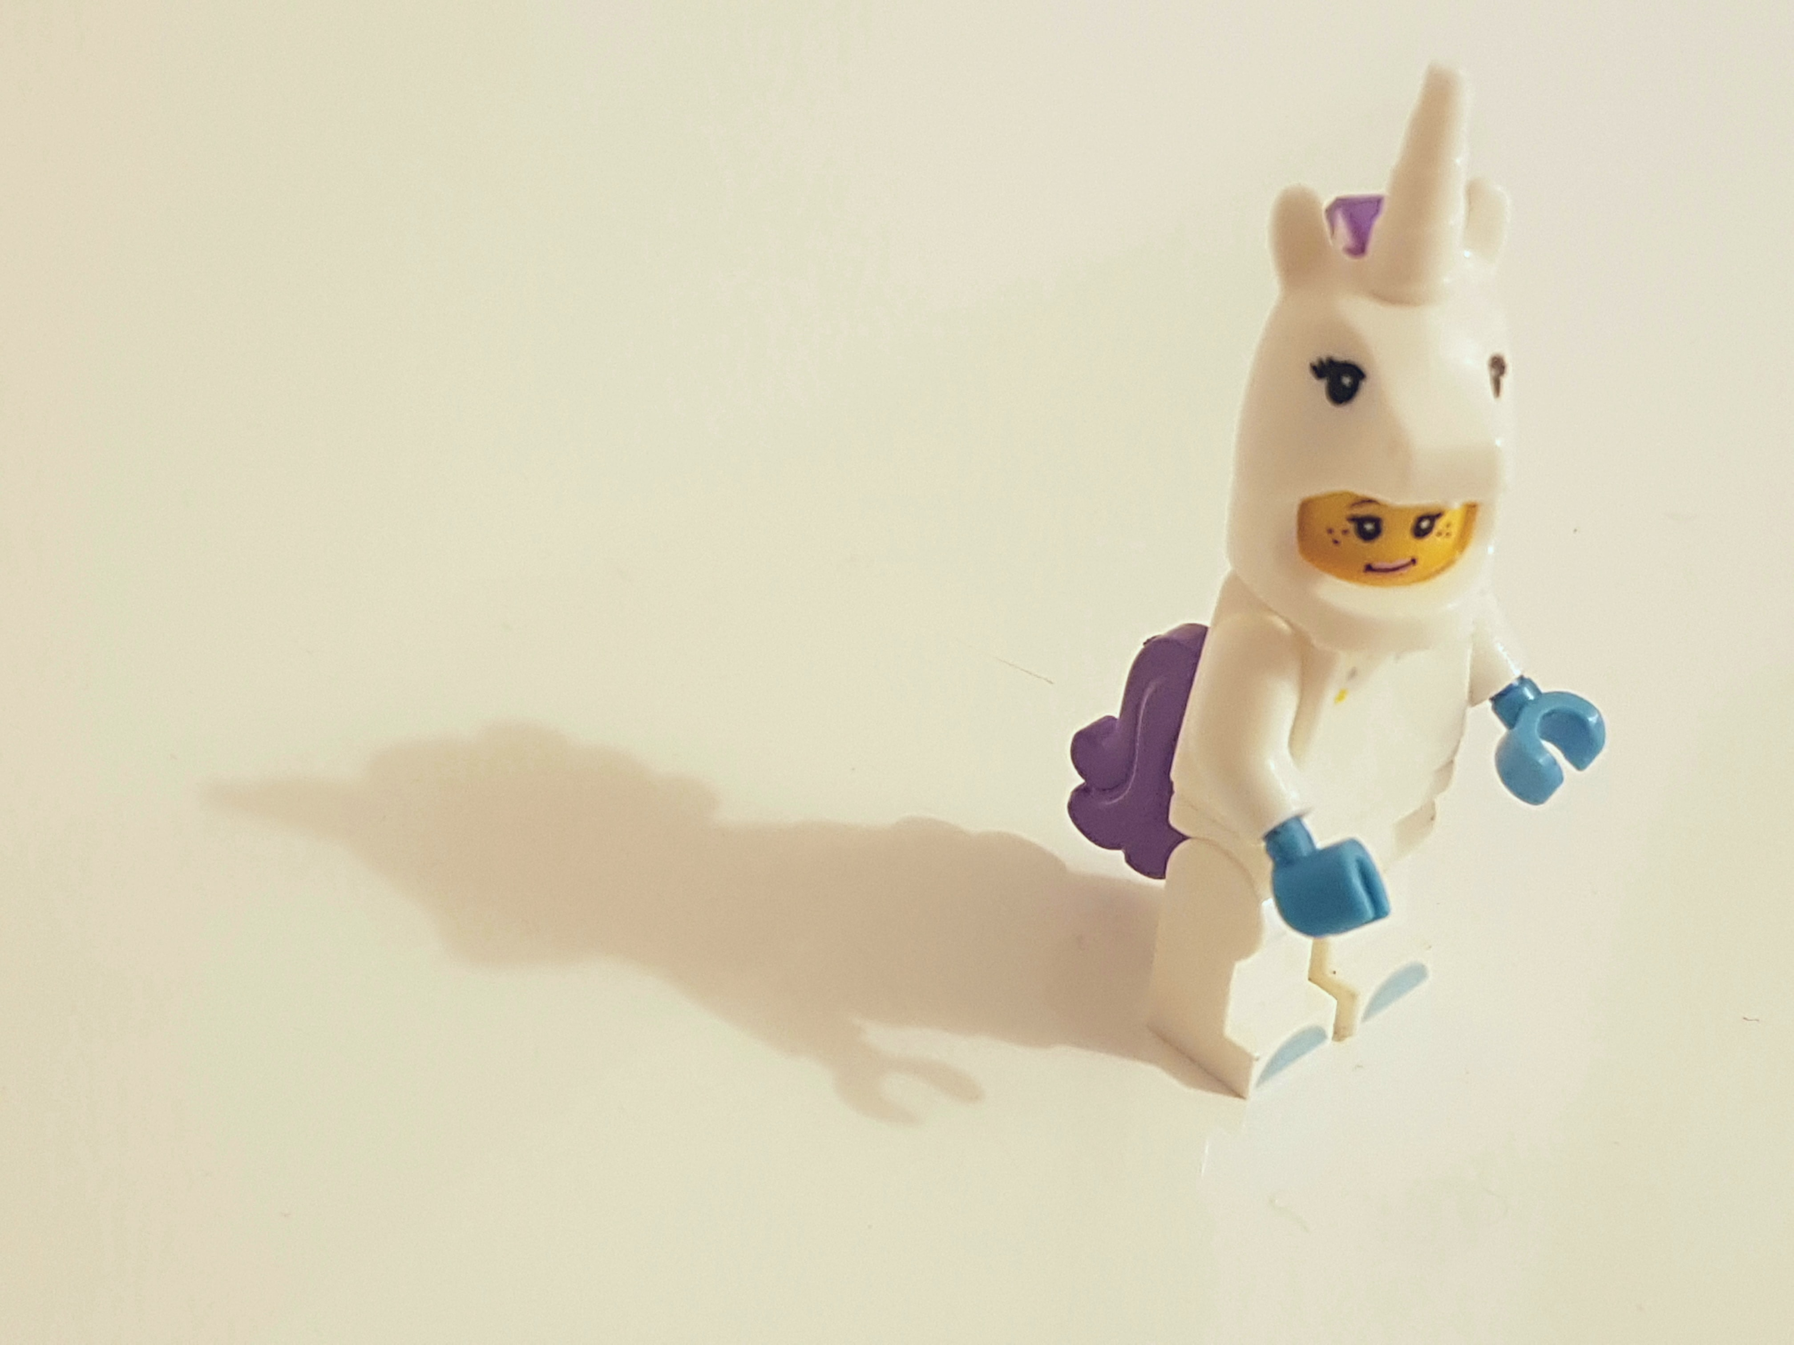

Bratwurst, Beer and Binaries: A conversation about stereotypes and unconscious bias
Cecilia Judmann

Slide 2

About me
Cecilia Judmann (she/her)
Events Marketing Manager, Redgate
LinkedIn: Cecilia Judmann
Twitter: @CJudmann

Slide 3
Agenda
Binaries
Stereotypes
Unconscious bias

Slide 4

Binaries

Slide 5
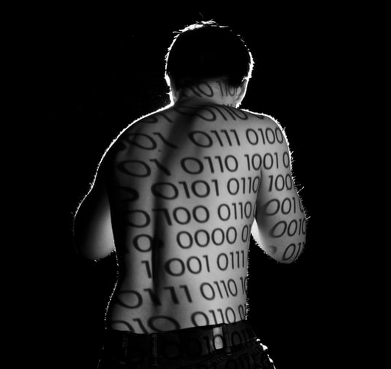

What are Binaries?

Slide 6
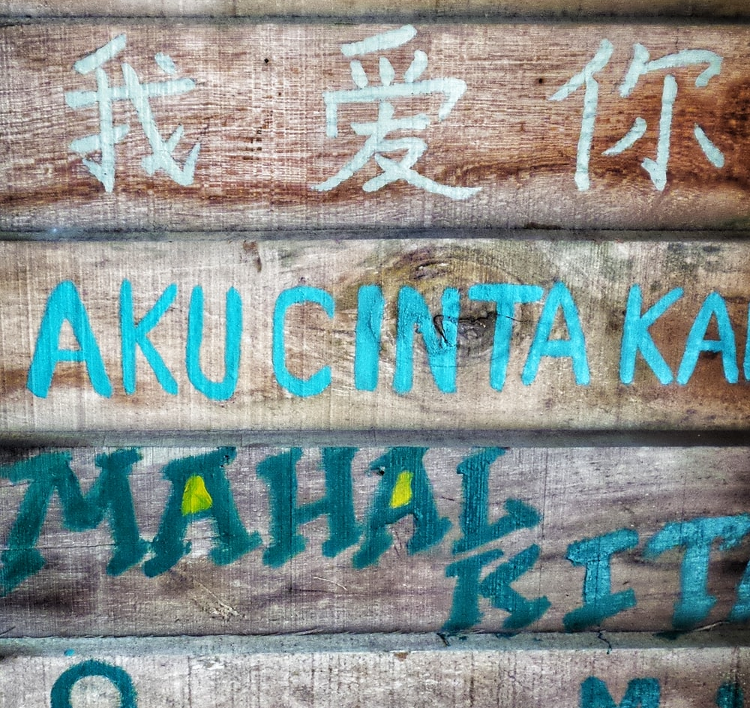
What do binaries have to do with language?
Stigmatize
Master-subservient relationship
Culture

Slide 7
Binaries in action
Masculine – Feminine
He - She
Strong – Weak
Active – Passive
Gay - Straight
Black – White
Dark – Light

Slide 8

Break down barriers
The power of language
Retell a story

Slide 9
Stereotypes

Slide 10
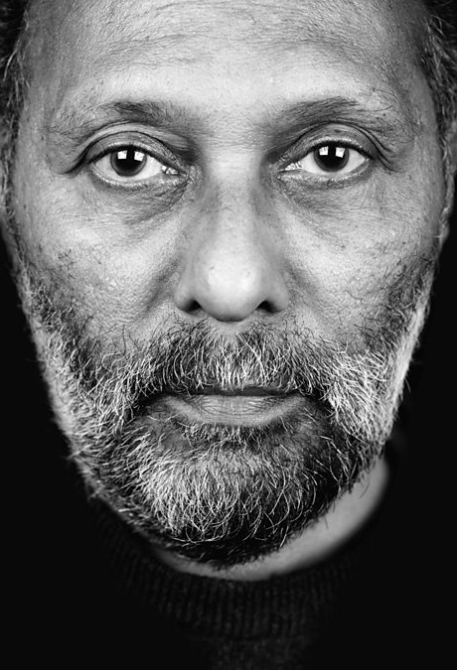
“fix and naturalize the difference between belongingness and otherness”
“symbolic boundaries between racially constituted categories”
“the double vision of the white eye”
“putting in the place of the bad old essential white subject, the new essentially good black subject”
Stuart Hall

Slide 11
“blacks have typically been the objects, but rarely the subjects, of the practices of representation. The struggle to come into representation was predicated on a critique of fetishization, objectification, and negative figuration which are so much a feature of the representation of the black subject. There was a concern not simply with the absence or marginality of the black experience, but with its simplification and its stereotypical character.” – Stuart Hall

Slide 12
Early Years
​
Girls should play with dolls and boys should play with trucks
Boys should be directed to like blue and green; girls toward red and pink
Boys should not wear dresses or other clothes typically associated with "girl's clothes“
As Adults
​
Victims of intimate partner violence are weak because they stay in the relationship
There is something wrong with a woman who doesn’t want children
Assertive women are unfeminine and are "bossy," "bitches” or “whores”
Women are natural nurturers; men are natural leaders
Women don’t need equal pay because they are supported by their husbands
Women who appear less feminine or reject advances from men are lesbians
Women with children are less devoted to their jobs
Men who spend time with family are less masculine and poor breadwinners
In heterosexual couples, women should take time off to care for children or elders
Men who are not aggressive and/or assertive are unmanly and likely gay
Women are too emotional to undertake certain kinds of work, especially while pregnant
During Youth
​​
Girls are better at reading and boys are better at math
Girls should be well behaved; boys are expected to act out
Girls and are not as interested as boys in STEM subjects;
Boys should engage in sports and refrain from more creative pursuits;
Boys and men are expected to use violence and aggression to prove their manliness;
A boy that doesn’t use violence or aggression is an understandable target for bullying;
Girls should be thin and beautiful to make them appealing to men;
Notes:
As per the Gender, Equality, Law Center

Slide 13

What can we do?
Representation matters!
how things are represented and the ‘machineries’ and regimes of representation in a culture do play a constitutive, and not merely a reflexive, after-the-event, role – Stuart Hall
Challenge stereotypes and when they’re used

Slide 14
Unconscious bias

Slide 15
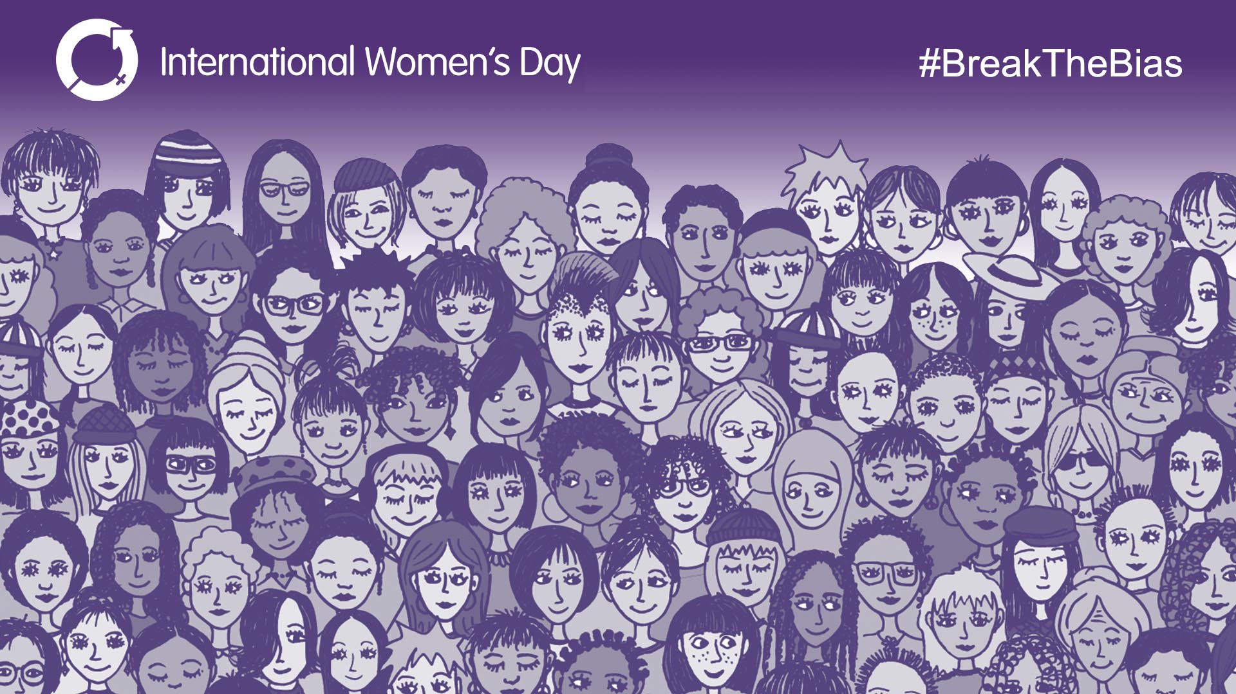
Imagine a gender equal world.
A world free of bias, stereotypes, and discrimination.
A world that is diverse, equitable, and inclusive.
A world where difference is valued and celebrated.
Together we can forge women's equality.
Collectively we can all #BreakTheBias.

Slide 16
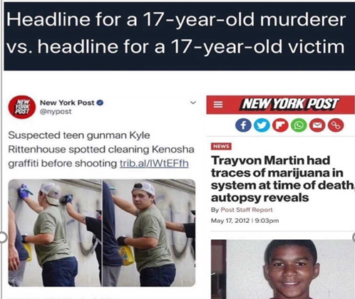
Unconscious bias

Slide 17

Unconscious bias
Three tips of combating unconscious bias:
Visualise
Courage
Normalise

Slide 18
REcap
Binaries
Stereotypes
Unconscious bias

Slide 19
THANKS
https://evals.datagrillen.com/

Slide 20
Reference and useful reading
Stuart Hall, New Ethnicities, 1989
Edward Said, Orientalism, 1978
Valerie Alexander, How to Outsmart your own Unconscious Bias

